Slide 1
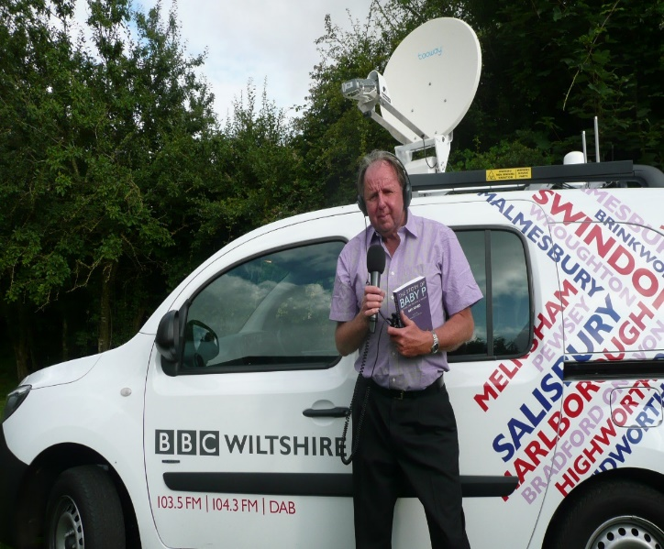
A BRIEF HISTORY OF SOCIAL WORK EDUCATION IN THE UK
DR RAY JONES
VLADIVOSTOK 2016
2008-2016
EMERITUS PROFESSOR OF SOCIAL WORK
KINGSTON UNIVERSITY AND ST GEORGE’S, UNIVERSITY OF LONDON
1992-2006
DIRECTOR OF SOCIAL SERVICES
WILTSHIRE

Slide 2
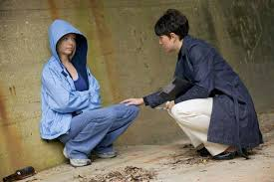
A BRIEF HISTORY OF SOCIAL WORK EDUCATION IN THE UK
EARLY 1900s TRAINING WITHIN CHARITIES OF CASEWORKERS
1950s THE BEGINNINGS OF UNIVERSITY EDUCATION FOR SOCIAL WORKERS
1960s SEPARATE EDUCATION AND TRAINING FOR DIFFERENT TYPES OF SOCIAL WORKERS
1970 A UNIFIED PROFESSION AND QUALIFICATION FOR SOCIAL WORKERS

Slide 3
A BRIEF HISTORY OF SOCIAL WORK EDUCATION IN THE UK
2002
SOCIAL WORKER A PROTECTED TITLE
REGISTRATION OF ALL SOCIAL WORKERS
ALL SOCIAL WORKERS TO HOLD UNIVERSITY DEGREES IN SOCIAL WORK
UNDERGRADUATE 3 AND 4 YEAR DEGREES AND POST-GRADUATE 2 YEAR DEGREES
CONTINUING PROFESSIONAL DEVELOPMENT

Slide 4
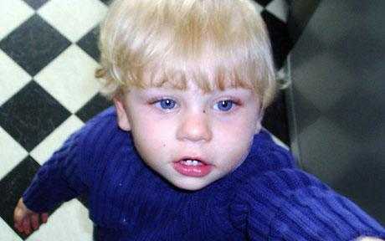
A BRIEF HISTORY OF SOCIAL WORK EDUCATION IN THE UK
RECENT DEVELOPMENTS SINCE 2008

Slide 5
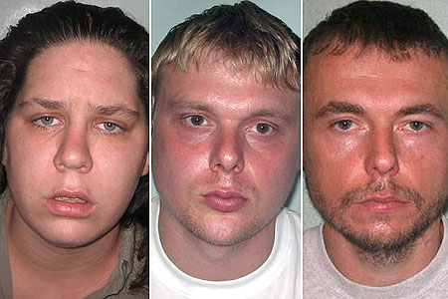

Slide 6
6

Slide 7
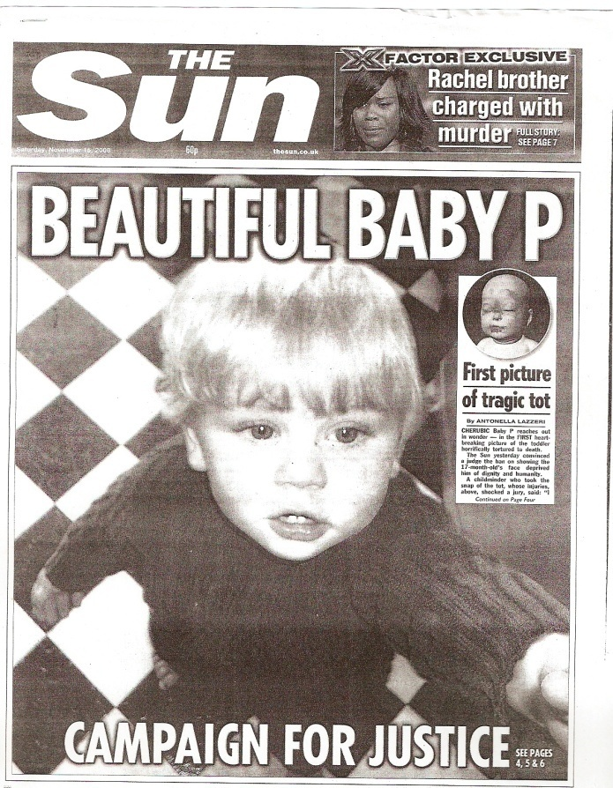
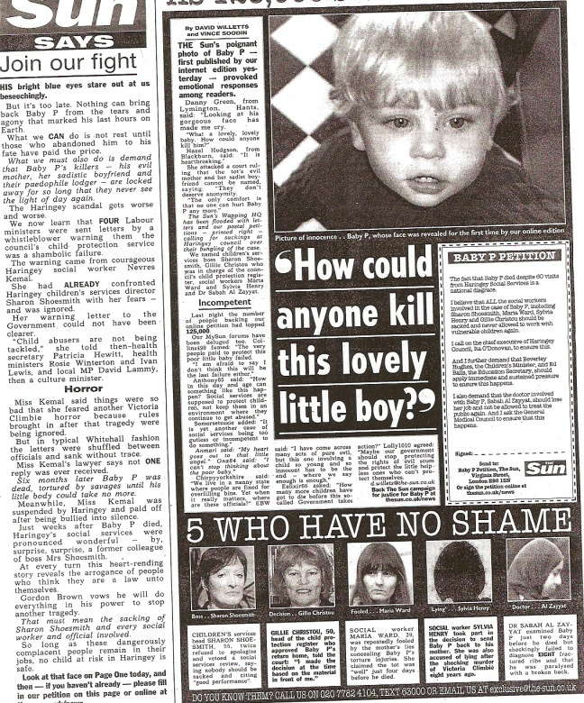

Slide 8
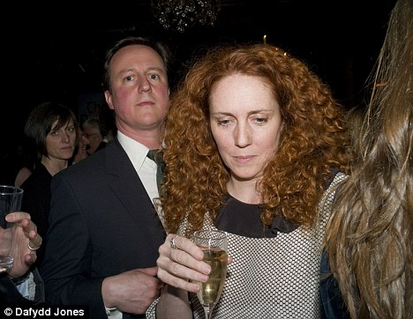

Slide 10
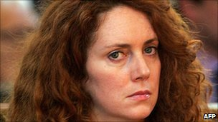
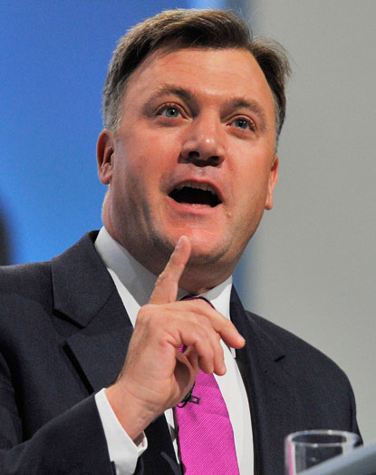
10

Slide 11
A BRIEF HISTORY OF SOCIAL WORK EDUCATION IN THE UK
RECENT DEVELOPMENTS SINCE 2008
A PROFESSIONAL CAPABILITIES FRAMEWORK
REVISING THE SOCIAL WORK DEGREE CURRICULUM
A REASSESSMENT OF ALL SOCIAL WORK COURSES
ASSESSED AND SUPPORTED FIRST YEAR IN EMPLOYMENT
THE INTRODUCTION OF COURSES FOR THE BEST GRADUATES

Slide 12
A BRIEF HISTORY OF SOCIAL WORK EDUCATION IN THE UK
RECENT DEVELOPMENTS
NATIONAL NEWSPAPER LEAGUE TABLES OF SOCIAL WORK COURSES
Satisfied with course | Satisfied with teaching | Satisfied with feedback | Student to staff ratio | Spend per student | Average entry tariff | Career after 6 months

Slide 13
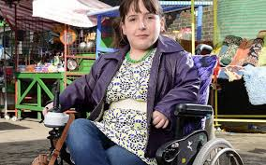
A BRIEF HISTORY OF SOCIAL WORK EDUCATION IN THE UK
CONTENT OF SOCIAL WORK DEGREE COURSES
PRACTICAL SOCIAL WORK COMPETENCIES [SKILLS LABORATORY]
DIRECT INVOLVEMENT OF SERVICE USERS
KNOWLEDGE OF SOCIOLOGY, PSYCHOLOGY AND HUMAN GROWTH AND DEVELOPMENT
UNDERSTANDING RESEARCH
ETHICS, LAW AND SOCIAL POLICIES
120 DAYS IN TWO ASSESSED PRACTICE PLACEMENTS

Slide 14
KINGSTON UNIVERSITY SOCIAL WORK SKILLS LABORATORY

Slide 15
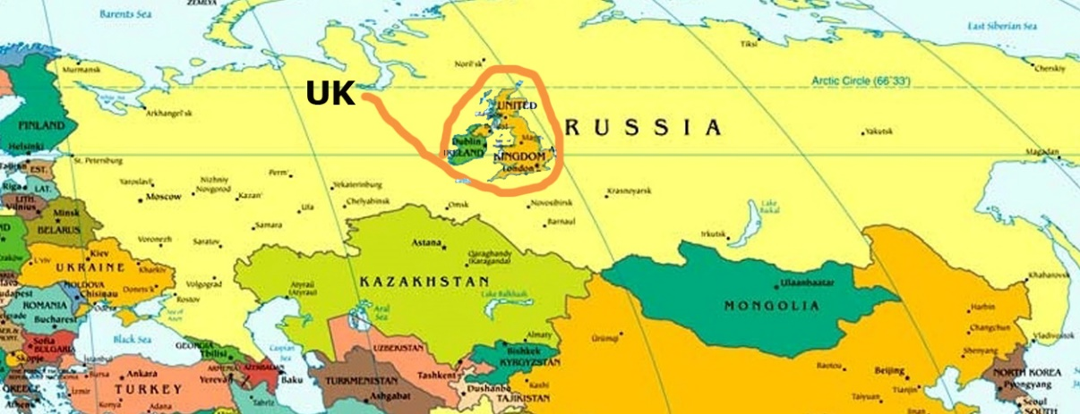
SOCIAL WORK EDUCATION IN THE UK
POPULATION OF UK 64.1m POPULATION OF RUSSIA 143.5m
120,000 REGISTERED SOCIAL WORKERS IN THE UK
21,000 MEMBERS OF THE BRITISH ASSOCATION OF SOCIAL WORKERS
87 UNIVERSITIES PROVIDE SOCIAL WORK EDUCATION
5400 STUDENTS GRADUATE AS SOCIAL WORKERS EACH YEAR

Slide 16
THANK YOU

